Slide 1
Objectives
Baselining
Key Aspects
Anomalies
Using Baseline
Best Practice

Slide 2
IT Security “Baselines”: An Alternative to Control Feasibility Analysis
What are “IT Baselines”?
There are a few different ways to interpret what defines baseline security. According to the National Institute of Standards and Technology (NIST), a “security control baseline” refers to “the set of minimum security controls defined for a low-impact, moderate-impact, or high-impact information system. A set of information security controls that has been established through information security strategic planning activities to address one or more specified security categorizations.”
Meanwhile, the Canadian Centre for Cyber Security defines its Baseline Cyber Security Controls as “a condensed set of advice, guidance, and security controls on how organizations can get the most out of their cyber security investments.”
Microsoft, on the other hand, identifies security baselines simply as standards defined by individual organizations that apps and devices must be compliant with. Microsoft’s own security baselines are groups of recommended configuration settings for different levels of impact, informed by feedback from various stakeholders.

Slide 3
IT Security “Baselines”: An Alternative to Control Feasibility Analysis
IT Baselines – “The Bare Minimum” Control
Cutting through all the jargon—think of baseline security as the bare minimum of what a business needs to sufficiently protect itself from vulnerabilities and threats while still being able to work efficiently and effectively. For MSPs, this extends to the bare minimum of security solutions that should be offered to deploy and maintain that protection.
Source on Baselining Overview:
https://www.itperfection.com/network-security/it-security-baselines-checklist-network-security-cybersecurity-windows-server-wireless-wifi-firewall-hardening/

Slide 4
IT Security “Baselines”: An Alternative to Control Feasibility Analysis
IT Baselines – Weighing the Bare Minimum in ICT Industry”
Unfortunately for us all, cybersecurity isn’t a one-size-fits-all, one-and-done type of thing. There’s not some magic cybersecurity easy button we can press to suddenly prevent and deflect all the bad behaviours that can compromise our business data. Good cybersecurity requires vigilance, awareness, training and monitoring. We all need it, no matter how small our business or uninteresting we think we might be as potential targets.
On the bright side, however, it’s not difficult to organize a standard set of policies, procedures and solutions to implement solid baseline security. General areas to focus on include security assessments, security for major productivity suites such as Microsoft 365, endpoint protection, email security and backup and disaster recovery.

Slide 5
Security Infrastructure Baseline
Security Baseline Overview
Effective network security demands an integrated defence-in-depth approach.
The focus is primarily on securing the network infrastructure itself, as well as all critical network services and data.
In order to provide this Infrastructure Security, one must first understand the Network Design as well as the Network Operation when it is at its normal performance/behaviour.
A Security Infrastructure Baseline is like a screen shot of the design and its basic operation, allowing for:
Anomalies and Trends to be identified
Audits to be performed
Security Risk Assessment to be created and verified

Slide 6
Key Areas of Consideration
Infrastructure Device Access
Routing Infrastructure
Device Resiliency
Network Telemetry/Monitoring
Network Policy Enforcement
Switching Infrastructure

Slide 7
Examples of Common IT Security Baselines
Common categories include:
Password baselines
Firewall baselines
Wireless security baselines
Baselines for Windows Workstations
”Hardening” baselines
Baselines for Virtual Machines or Physical Server
Infrastructure Device Access baselines
More information on common baselines:
https://www.sherweb.com/blog/security/what-is-baseline-security/#:~:text=According%20to%20the%20National%20Institute,or%20high%2Dimpact%20information%20system.

Slide 8
Examples of Common IT Security Baselines
Category examples include:
Password: Account holders must have the ability to either activate an account and set a password before use or require users to set a password during initial access to a system.
Firewall: All Firewall implementations should adopt the principal of “least privilege” and deny all inbound traffic by default.
Wireless: Limit physical access to the network room or wiring closet and secure access points with a Security brackets or locks
Windows Workstations: Block executable content from email client and webmail and block Office applications from injecting code into other processes
Hardening: Confirming that security updates are installed on a regular basis.

Slide 9
Identify Anomalies / Trends
Comparing the Baseline with the current status of the infrastructure the security team can determine:
Changes in network utilisation patterns, due to:
Trends:
Increase of # users in the infrastructure
Change of Software in the organisation
Change in the user behaviour with respect to use and storage of data
Anomalies:
Security violations
Intentional
Unintentional
Malware infection
Attacks to:
DoS, DDoS
Newly discovered Vulnerabilities
Notes:
Assess adequacy of security controls compared to defined requirements and in security. light of current vulnerabilities
Reassess what security exceptions need to be monitored on an ongoing basis
Evaluate how well the security mechanisms are operating and check for weaknesses, such as intrusion detection, penetration and stress testing, and testing of contingency plans •
Ensure that exceptions are acted upon
Monitor compliance to key controls

Slide 10
Using the Baseline
Assess the adequacy of current security controls compared to defined requirements and in light of current vulnerabilities
Reassess what security exceptions need to be monitored on an ongoing basis
Evaluate how well the security mechanisms are operating and check for weaknesses, such as intrusion detection, penetration and stress testing, and testing of contingency plans
Ensure that exceptions are acted upon
Monitor compliance to key controls

Slide 11
Audits
The Security Infrastructure Baseline will enable Audits to be performed at several levels:
Risk Assessments
Performance
Security Breaches
Policies and Procedures
Organisations will usually conduct ‘Business Analysis’ and the auditing process will contribute to increased performance and continuity.

Slide 12
Risk Categories
Several categories of Risk can be identified through a well defined baseline:
Technical Risks
Hardware physical exposure, easy access,
Hardware Incorrect Configuration
Hardware Misuse
Lack of Software Patches
Software Vulnerabilities
Security Risk:
Trojan Horse Infection
Root Kits
DoS
Man-in-the-middle
Operating Systems Vulnerabilities
Physical Risks include:
Alarms Disabled
Locks left open
Secure areas left open with no security personnel
Equipment damage
Equipment theft
Notes:
Technical Risks include, but are not limited to:
Hardware physical exposure, easy access,
Hardware Incorrect Configuration
Hardware Misuse
Lack of Software Patches
Software Vulnerabilities
Security Risk:
Trojan Horse Infection
Root Kits
DoS
Man-in-the-middle
Operating Systems Vulnerabilities
Programming Languages and mobile codes (Java, ActiveX, Scripts)
Physical Risks include:
Alarms Disabled
Locks left open
Secure areas left open with no security personnel
Equipment damage
Equipment theft
Communication Risks:
No standards for accessing personnel at different levels of the organisation
‘ No confirmation/verification of source of communications
Training Risks (or lack of training)
User training non existent or inappropriate
non verification of continuing understanding of current policies
Violation of Policies and Regulations
Intellectual Property Risks
Identity theft
Illegal Use of resources (such as the Internet)
Industrial Espionage
Tunneling

Slide 13
Risk Categories
Communication Risks:
No standards for accessing personnel at different levels of the organisation
No confirmation/verification of source of communications
Training Risks (or lack of training)
User training non existent or inappropriate
non verification of continuing understanding of current policies
Violation of Policies and Regulations
Intellectual Property Risks
Identity theft
Illegal Use of resources (Internet)
Industrial Espionage
Tunnelling

Slide 14
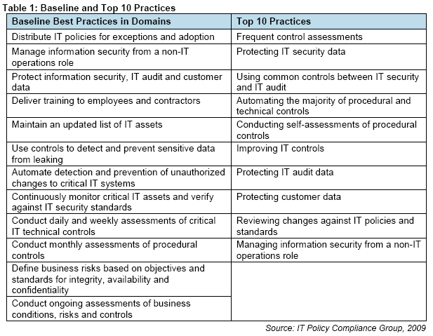
Best Practice Examples

